Slide 1

Integrating Domain and GPO Installation
Group Members:
Aagam Shah
Amandeep Kaur
Feethu James
Rahul Rajan
Ramya Kanapuram

Slide 2
Agenda
Project Outline
Project Objectives
Infrastructure Design
Domain and Server Configuration
Cross Domain Communication
GPO Configuration
Validation
Conclusion

Slide 3
Project Outline
The project outlines the implementation of communication between the merged companies with infrastructure environment.

Slide 4
Project Objectives
The main objective of the project is to configure Group policy objects (GPO) and print, file servers.

Slide 5
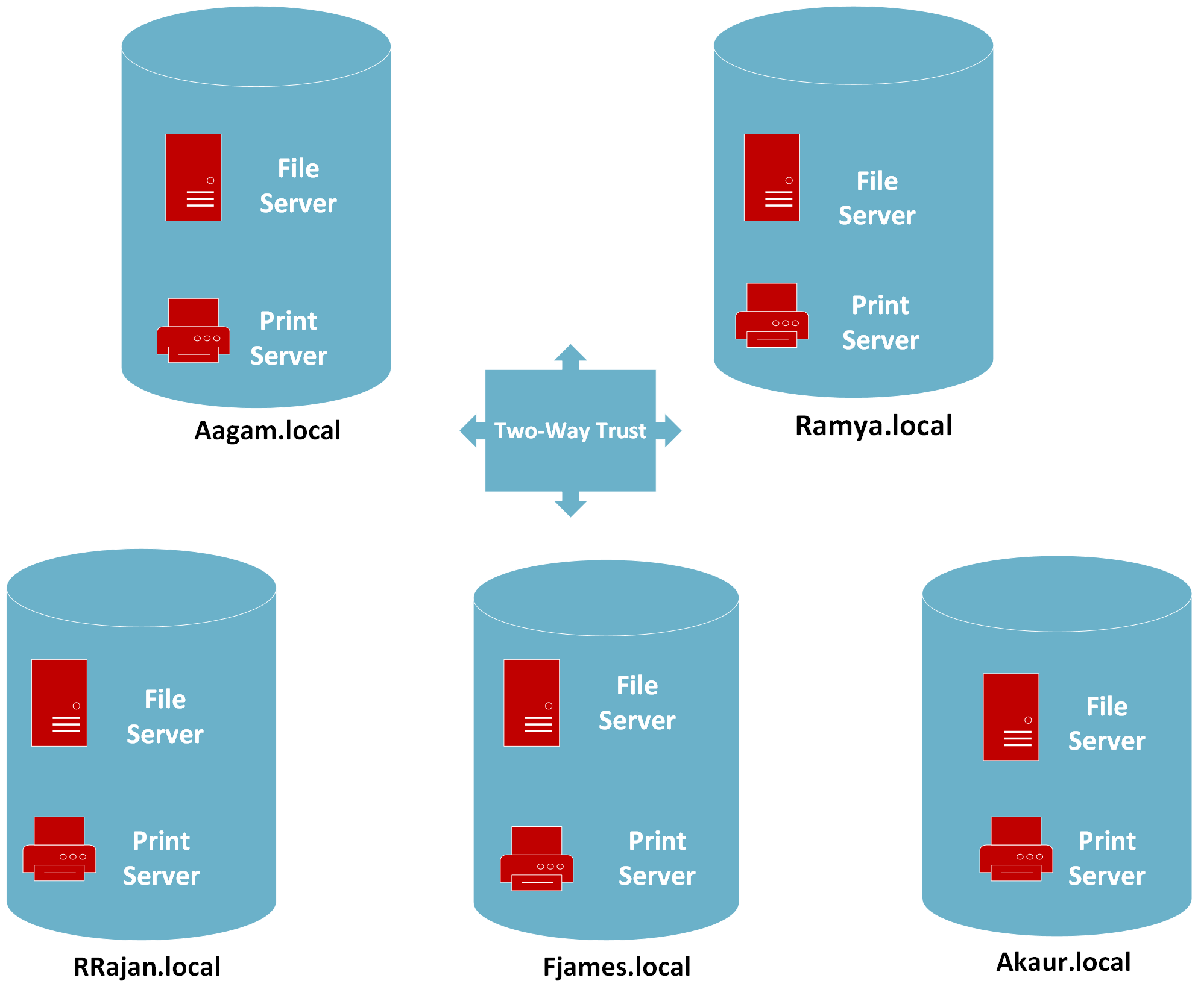
Infrastructure Design

Slide 6

Domain and Server Configuration
Domain and server configuration involves setting up the technical infrastructure for hosting a website. This includes:
-Domain Configuration: Buying a domain name and managing DNS settings to point to the server.
- Server Configuration: Setting up the server hardware and software (like operating system, web server, and database) and optimizing for security and performance.

Slide 7

Cross Domain Communication - (trust)
“Domain communication" typically refers to the interaction between different domains (websites) on the internet. This interaction can involve various scenarios, such as sharing data, resources, or functionality between domains.

Slide 8
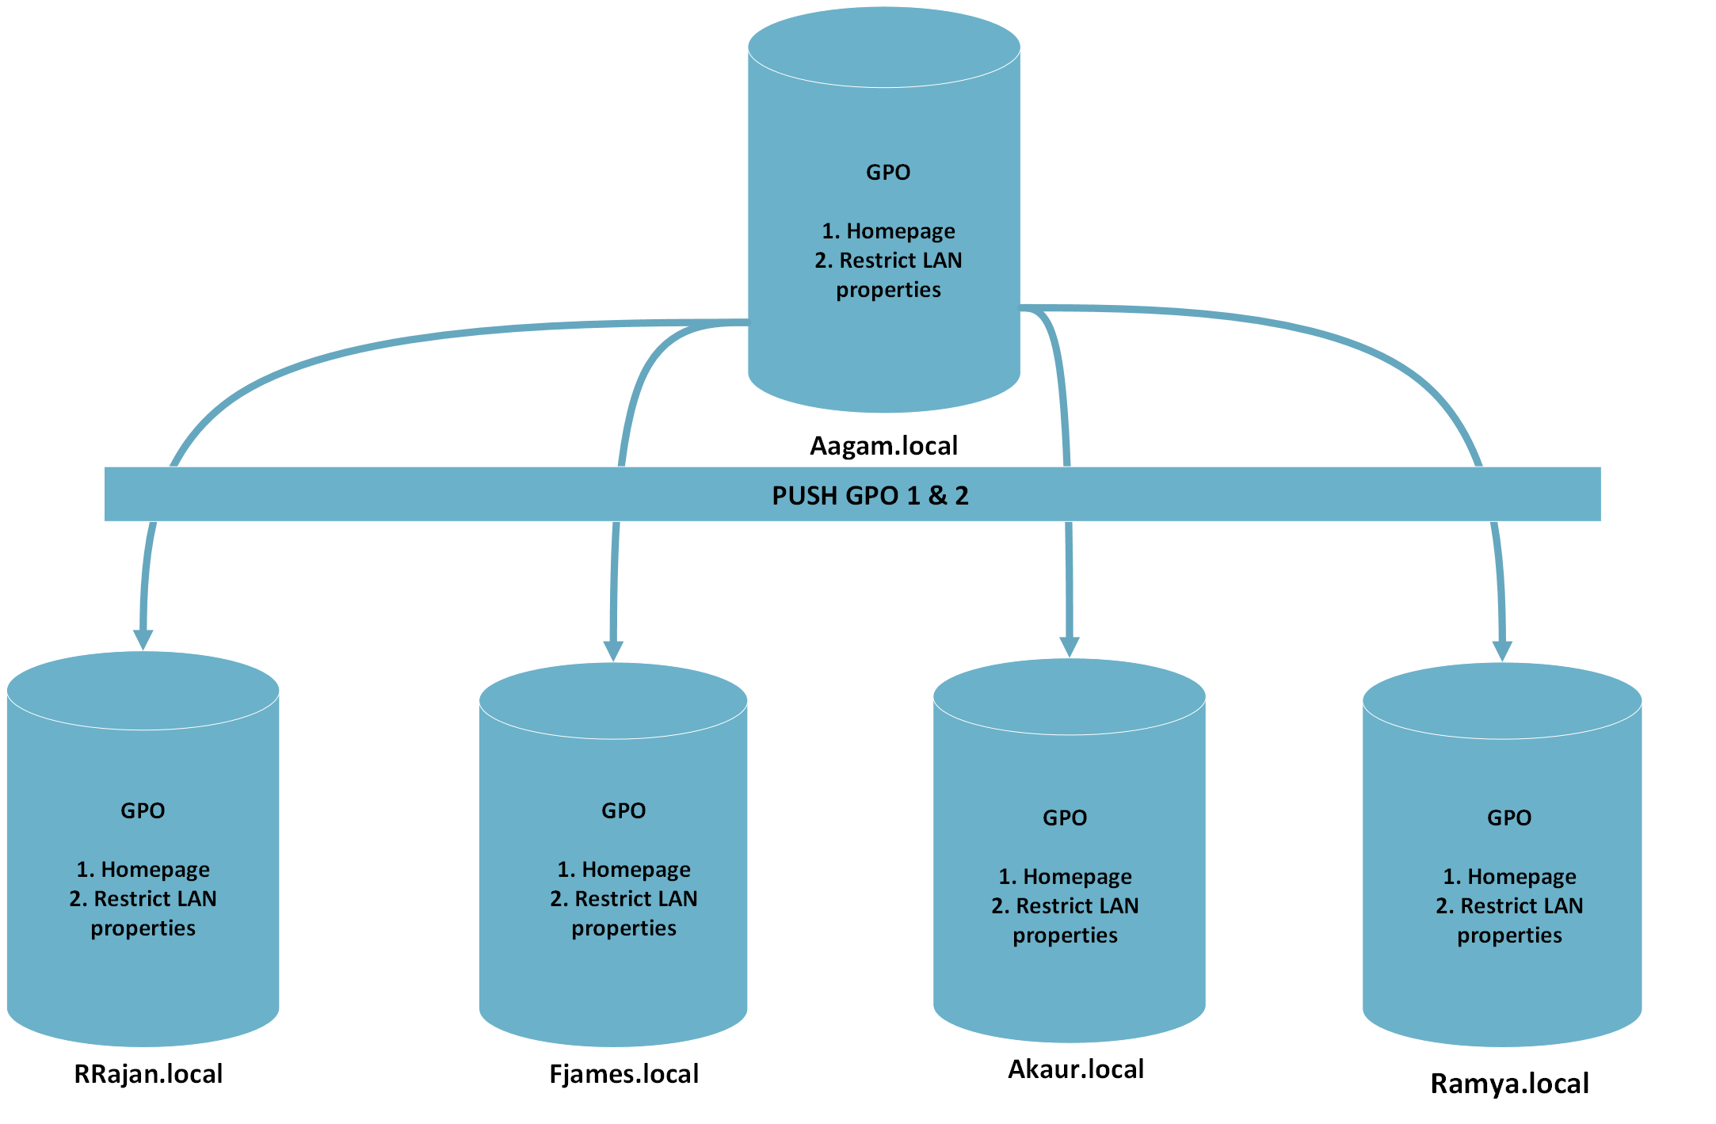
GPO Configuration

Slide 9

Validation-Home Page

Slide 10
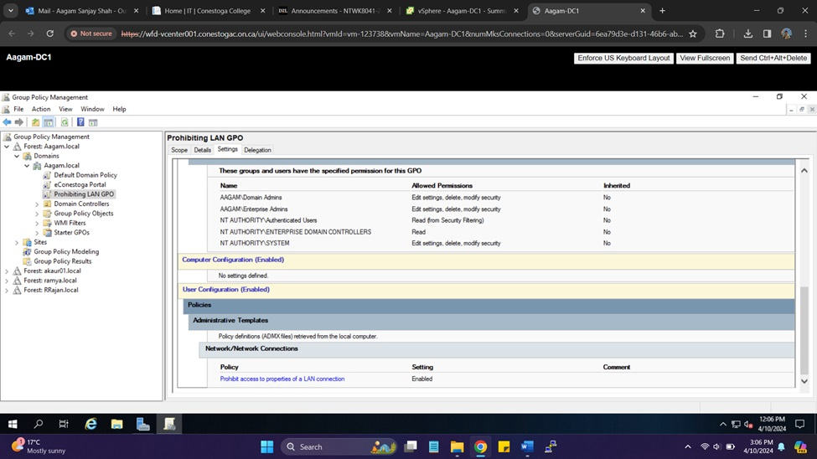
Validation- Prohibiting LAN

Slide 11

Conclusion
Comprehensive setup and configuration of all the servers within the domain network.
Established trust relationships between all participating companies within network infrastructure.
Implemented secure and efficient file sharing mechanism within company network.
Implemented Group Policy Objects to enforce security measures effectively.

